Slide 1

Data Mining (Intro)
Data Mining
Dr. Sajarwo Anggai, S.ST., M.T. NIDN : 0421108703

Slide 2
Apa itu Data Mining?
Data mining can be defined in several ways, which differ primarily in their focus. One of the earliest definitions is the following:
The non-trivial extraction of implicit, previously unknown, and potentially useful information from data. (Frawley et al., 1991)
Statistical modeling: The use of parametric statistical algorithms to group or predict an outcome or event, based on predictor variables. Data mining: The use of machine-learning algorithms to find faint patterns of relationship between data elements in large, noisy, and messy data sets, which can lead to actions to increase benefit in some form (diagnosis, profit, detection, etc.).
Knowledge discovery: The entire process of data access, data exploration, data preparation, modeling, model deployment, and model monitoring. This broad process includes data mining activities, as shown in Fig. 2.1.
Data science: The extension of knowledge discovery into data architecture of analytic data marts on one hand and complex image, speech, and textual analysis on the other hand with highly evolved machine-learning algorithms.
Ref: Robert Nisbet, Gary Miner, and Ken Yale. 2017. Handbook of Statistical Analysis and Data Mining Applications, Second Edition (2nd. ed.). Academic Press, Inc., USA.

Slide 3
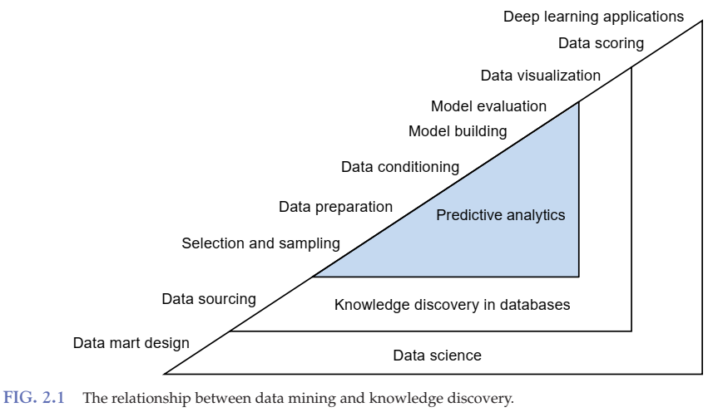
Ref: Robert Nisbet, Gary Miner, and Ken Yale. 2017. Handbook of Statistical Analysis and Data Mining Applications, Second Edition (2nd. ed.). Academic Press, Inc., USA.

Slide 4
Apa itu Data Mining?
Data mining, also known as knowledge discovery in data (KDD), is the process of uncovering patterns and other valuable information from large data sets. (IBM)
Simply put, it is the process of discovering insights when dealing with large volumes of data. This data can come from many sources or a single database, and insights may be generated through manual discovery or automation. (Oracle)
Data mining is the process of discovering meaningful correlations, patterns and trends by sifting through large amounts of data stored in repositories. Data mining employs pattern recognition technologies, as well as statistical and mathematical techniques. (Gartner)

Slide 5
Apa itu Data Mining?
Disiplin ilmu yang mempelajari metode untuk mengekstrak pengetahuan atau menemukan pola dari suatu data yang besar
Ekstraksi dari data ke pengetahuan:
Data: fakta yang terekam dan tidak membawa arti
Informasi: Rekap, rangkuman, penjelasan dan statistik dari data
Pengetahuan: pola, rumus, aturan atau model yang muncul dari data
Nama lain data mining:
Knowledge Discovery in Database (KDD)
Big Data
Business intelligence
Knowledge extraction
Pattern analysis
Information harvesting
Ref: Romi Satria Wahono, Data Mining – IlmuKomputer.Com

Slide 6
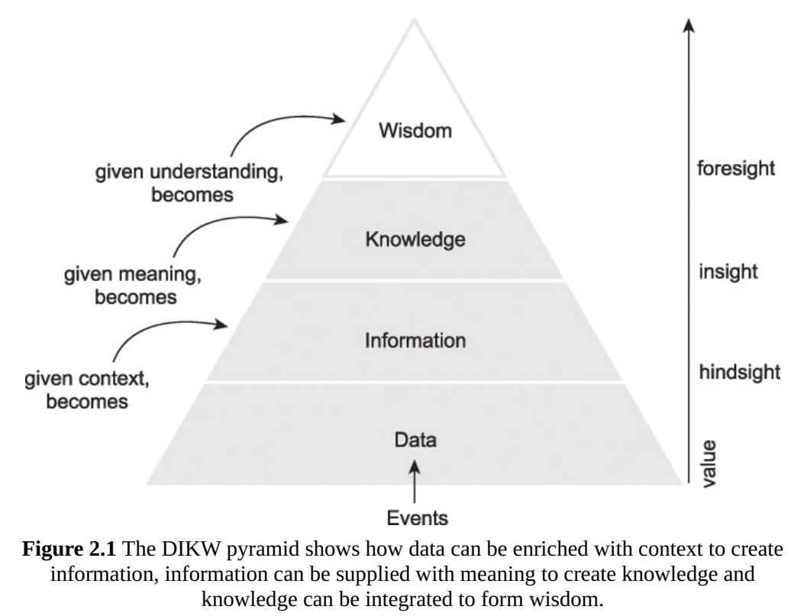
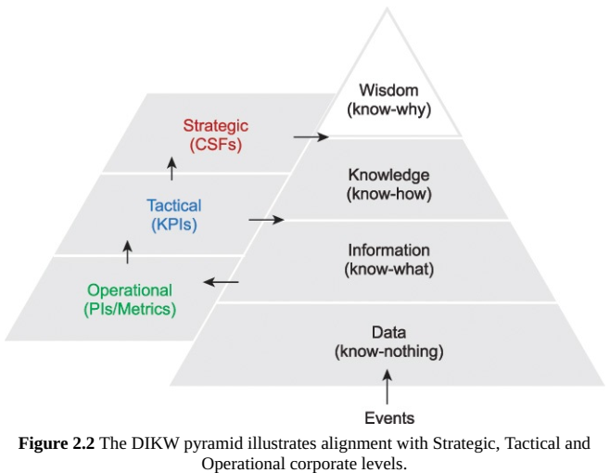
Data-Information-Knowledge-Wisdom (DIKW)
PI : Performance Indicator
KPI : Key Performance Indicator
CSF : Critical Success Factor
Thomas Erl, Wajid Khattak, and Paul Buhler. 2016. Big Data Fundamentals: Concepts, Drivers & Techniques (1st ed.). Prentice Hall Press, Upper Saddle River, NJ, USA.
Notes:
http://image-src.bcg.com/Images/The_Digital_Imperative_Mar_2015_tcm9-80124.pdf

Slide 7
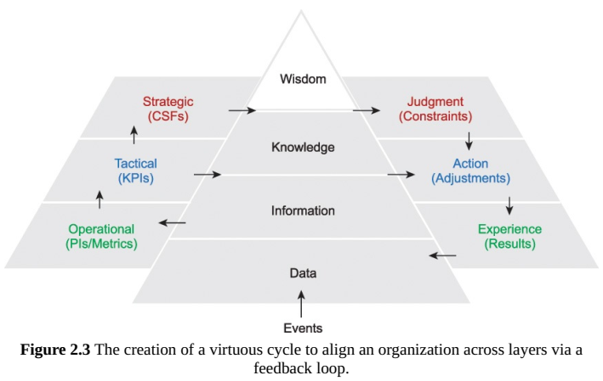
Feedback Loop
Thomas Erl, Wajid Khattak, and Paul Buhler. 2016. Big Data Fundamentals: Concepts, Drivers & Techniques (1st ed.). Prentice Hall Press, Upper Saddle River, NJ, USA.
Notes:
http://image-src.bcg.com/Images/The_Digital_Imperative_Mar_2015_tcm9-80124.pdf

Slide 8
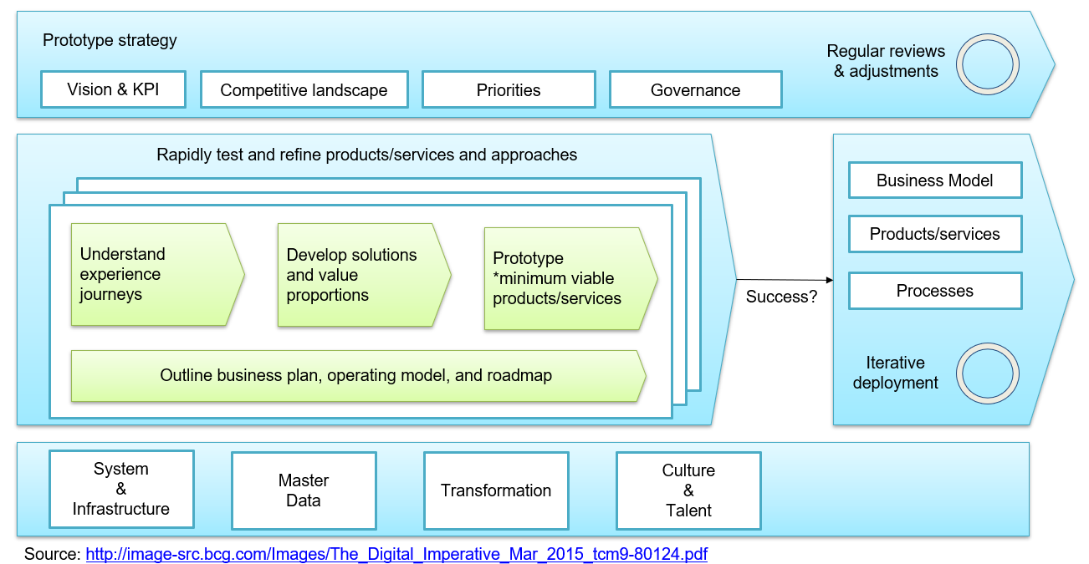
Digital Transformation

Slide 9
Big Data
According to Thomas et al. Big data addresses: processing structure, semi-structure or unstructured data and detecting/finding hidden information from large dataset in time-sensitive manner.
The result of the big data processing are:
Accurate Predictions
Fault & Fraud Detection
Improved Decision-making
Scientific Discovery
etc.
Thomas Erl, Wajid Khattak, and Paul Buhler. 2016. Big Data Fundamentals: Concepts, Drivers & Techniques (1st ed.). Prentice Hall Press, Upper Saddle River, NJ, USA.

Slide 10
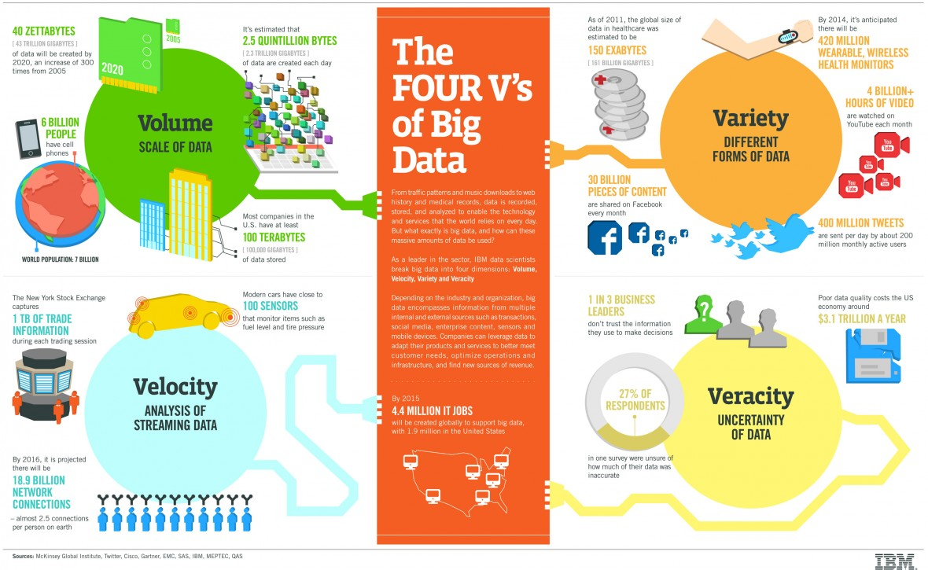
The Fours V’s of Big Data
https://www.ibmbigdatahub.com/infographic/four-vs-big-data

Slide 11
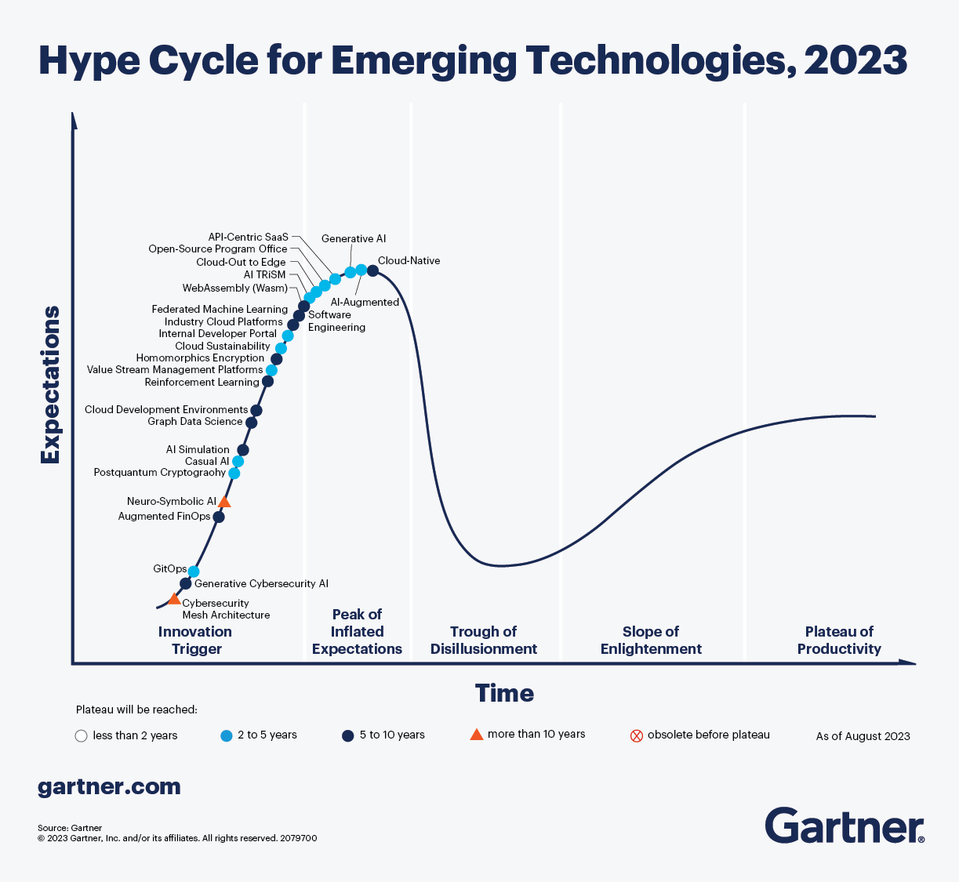
The 2023 Gartner Hype Cycle identifies 25 must-know emerging technologies designed to help enterprise architecture and technology innovation leaders:
Evaluate the business impact of emerging technologies
Examine and explore potentially transformative technologies
Strategize how to benefit from these technologies

Slide 12
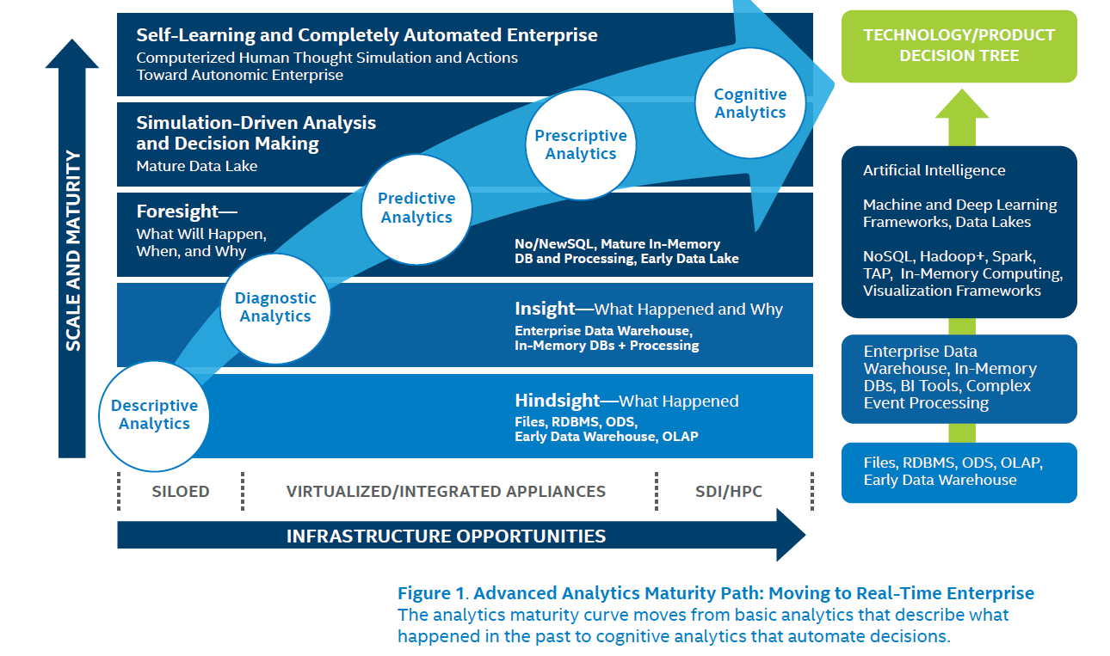
Anda dimana?
Intel, Getting started with advanced analytics

Slide 13
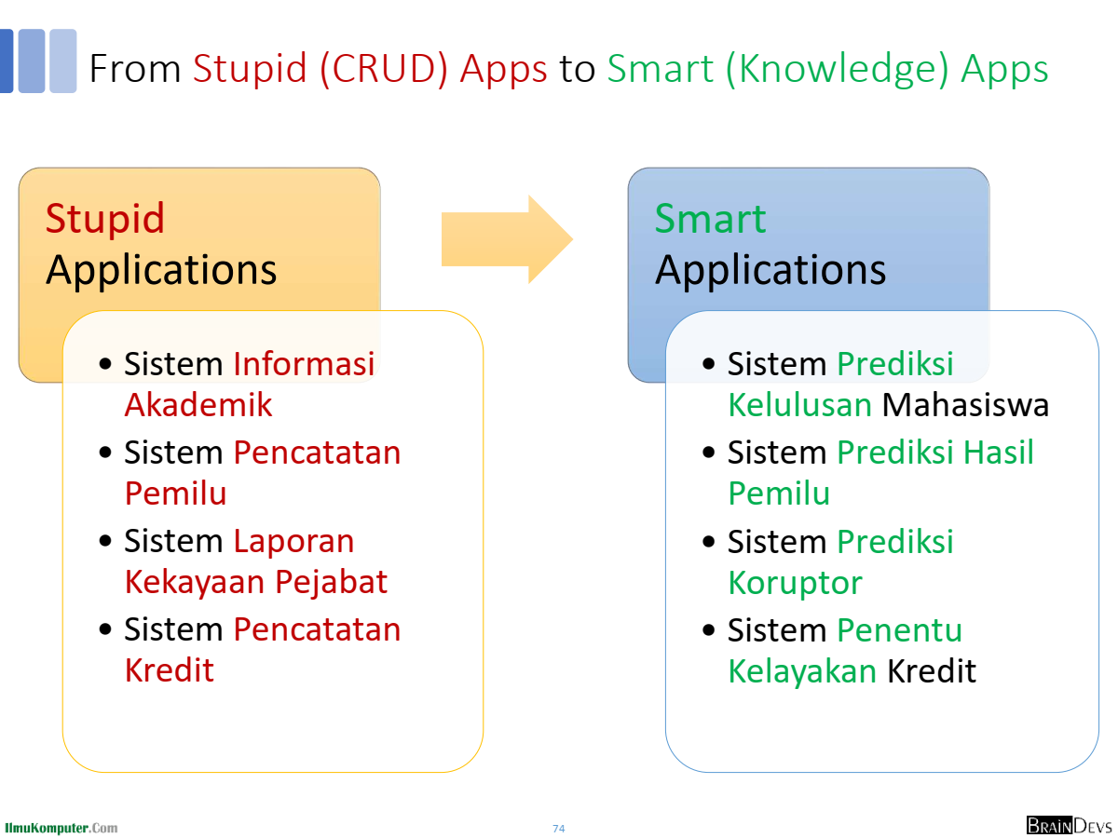

Slide 14
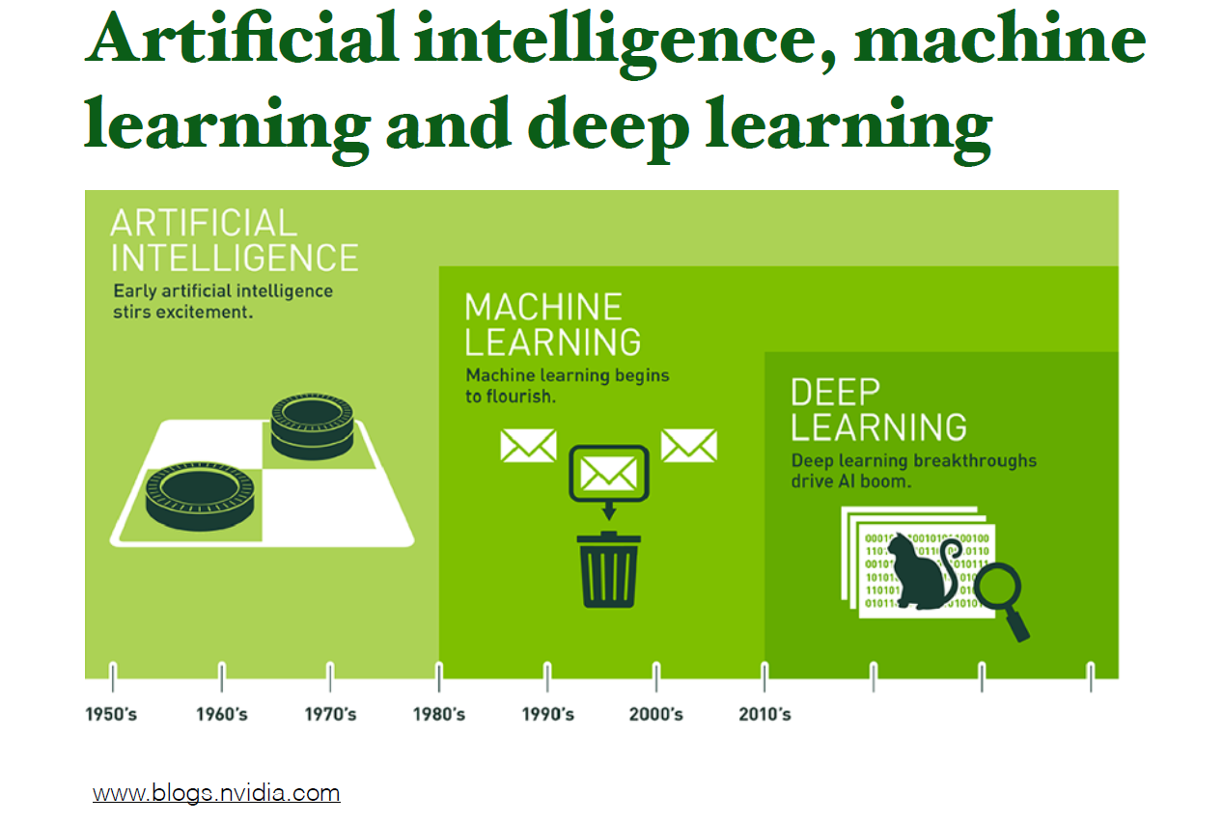

Slide 15
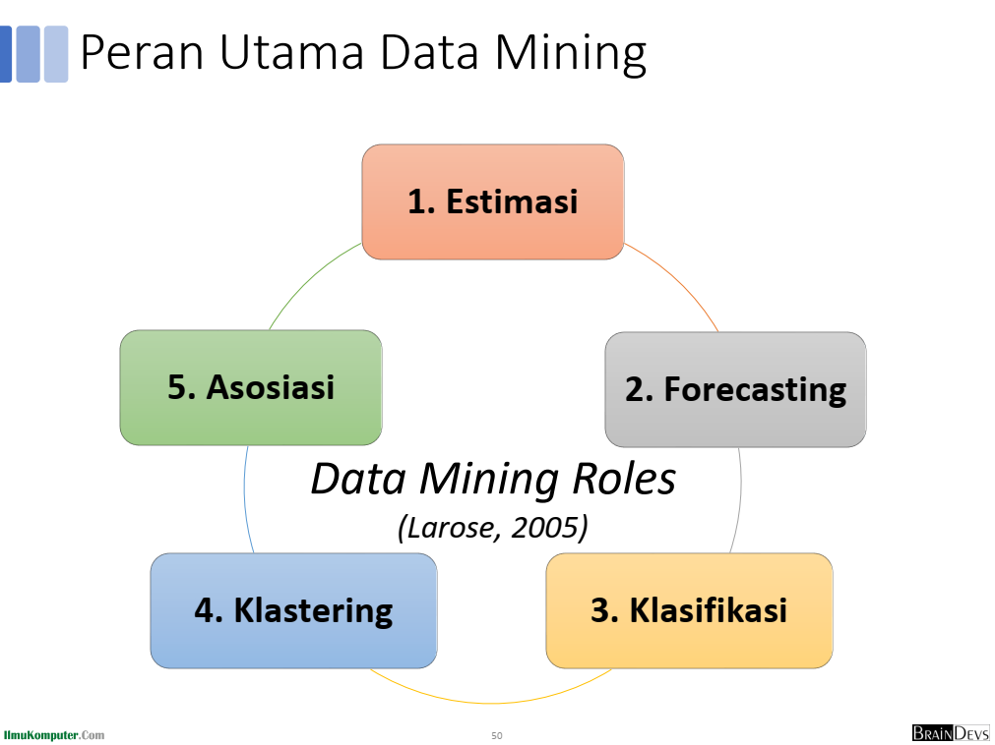

Slide 16
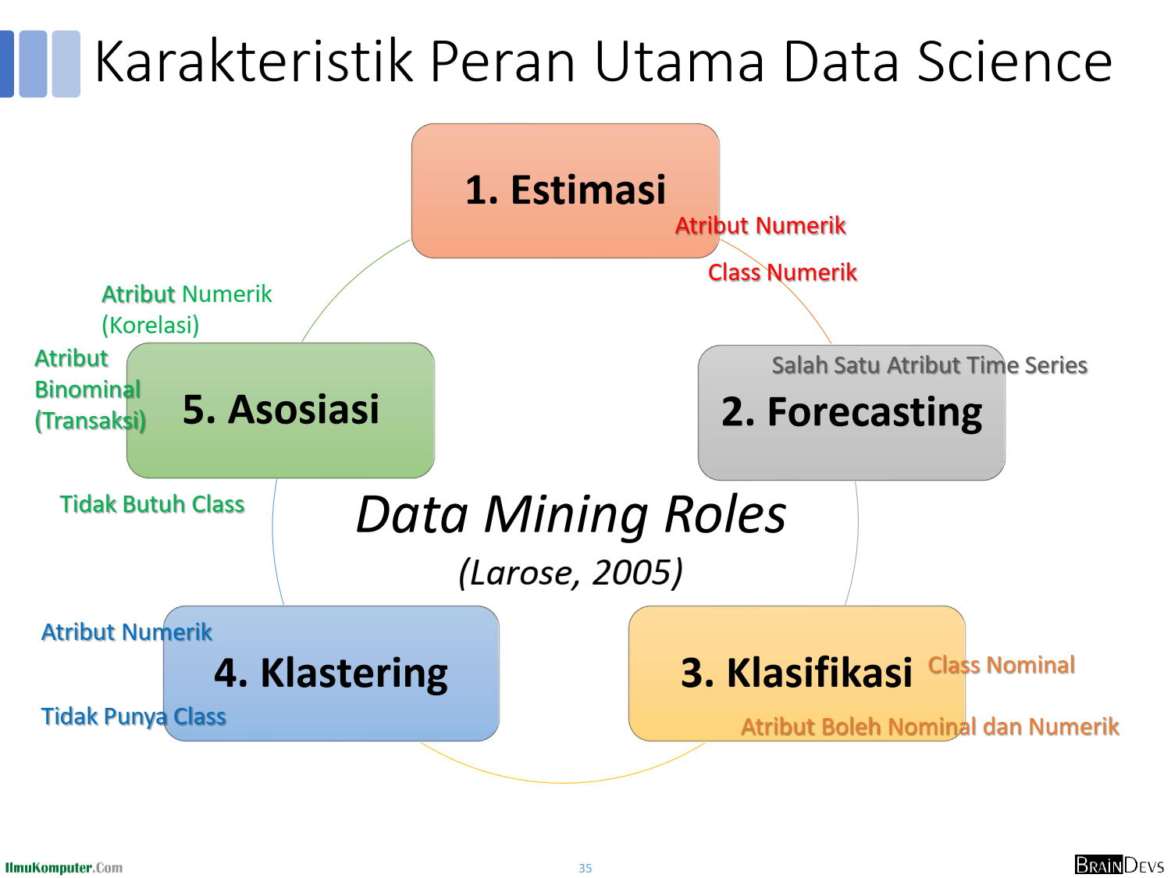

Slide 17
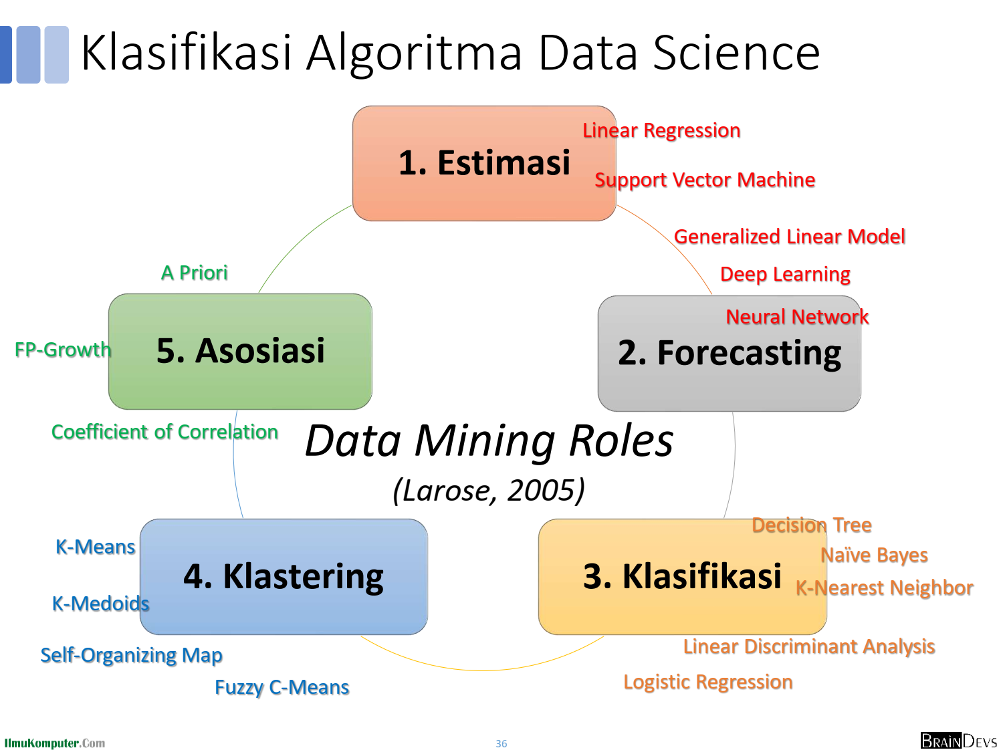

Slide 18
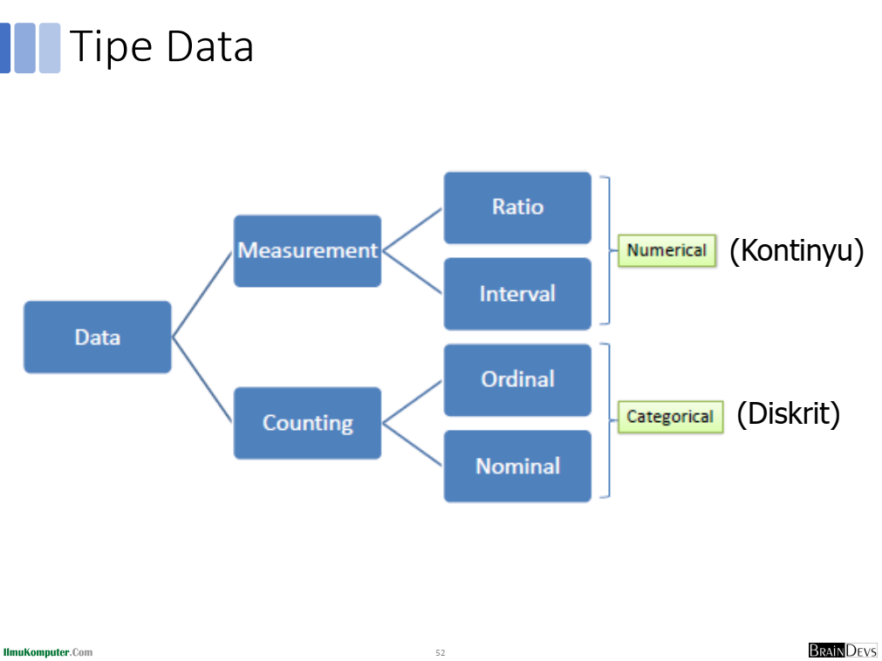

Slide 19
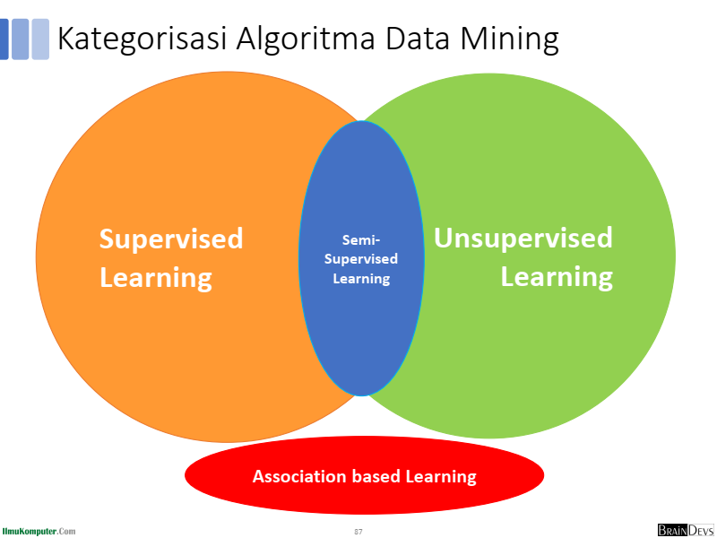

Slide 20
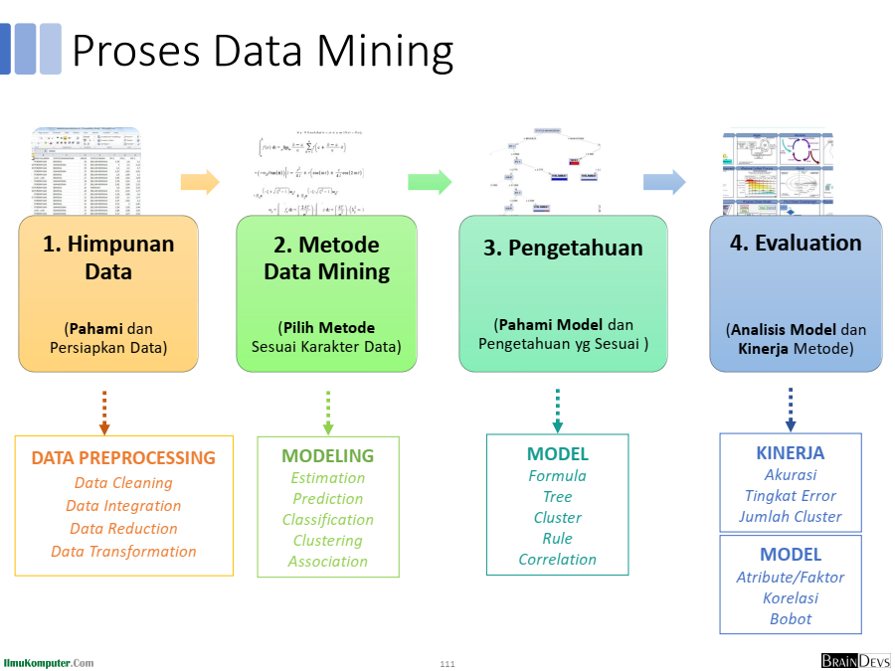

Slide 21
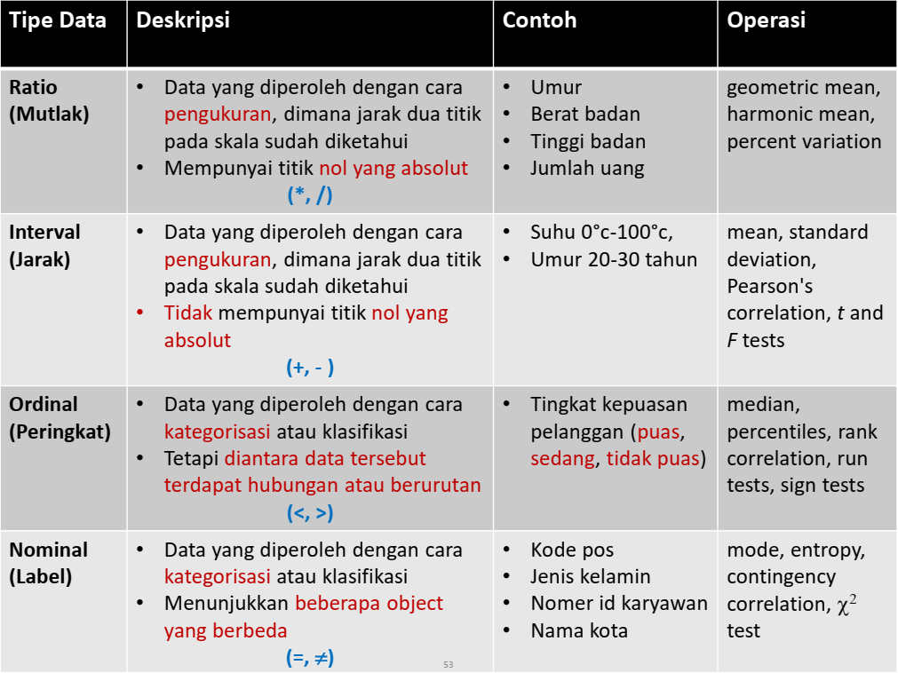

Slide 22
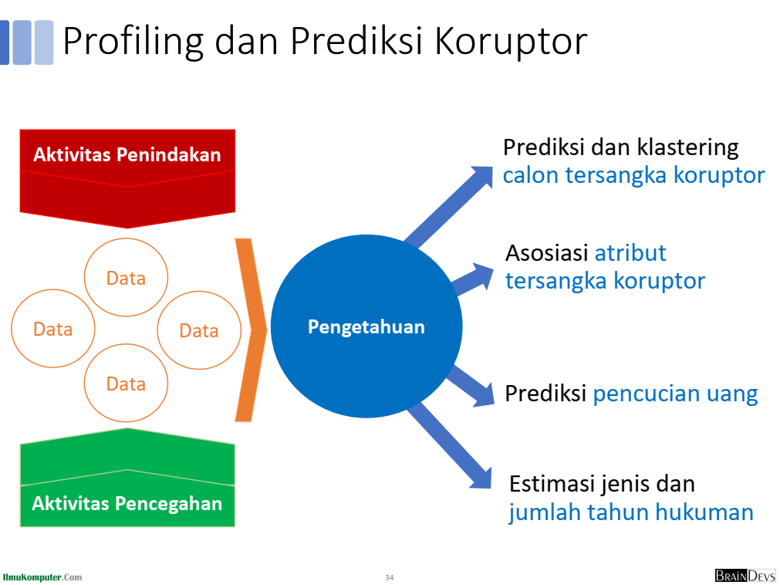

Slide 23
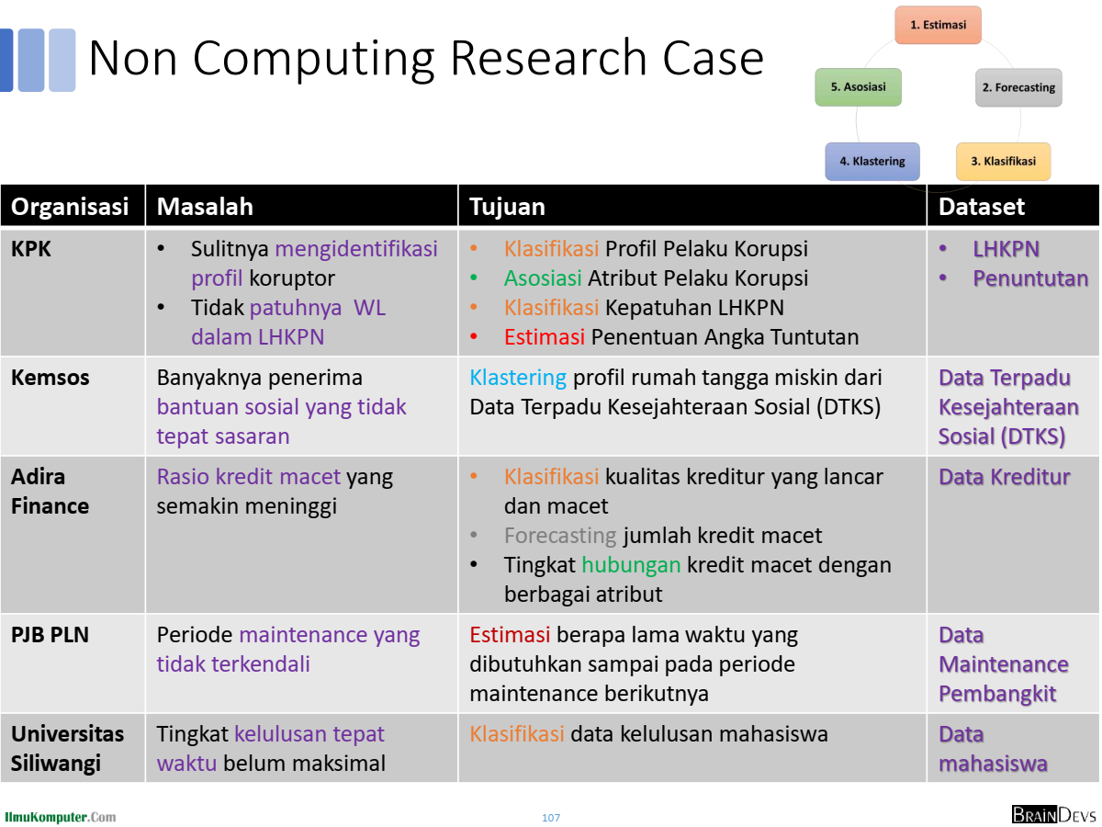

Slide 24
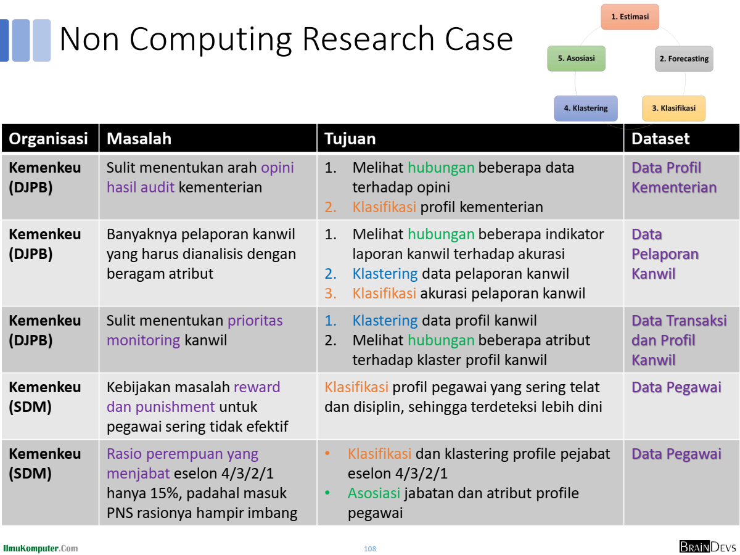

Slide 25
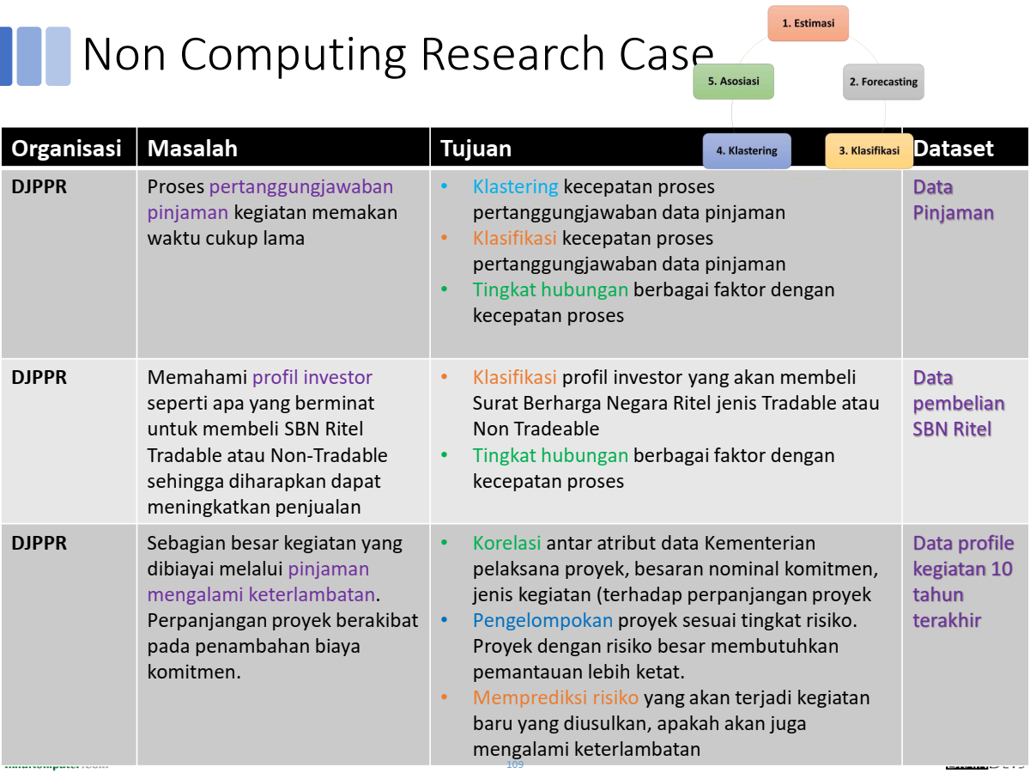

Slide 26
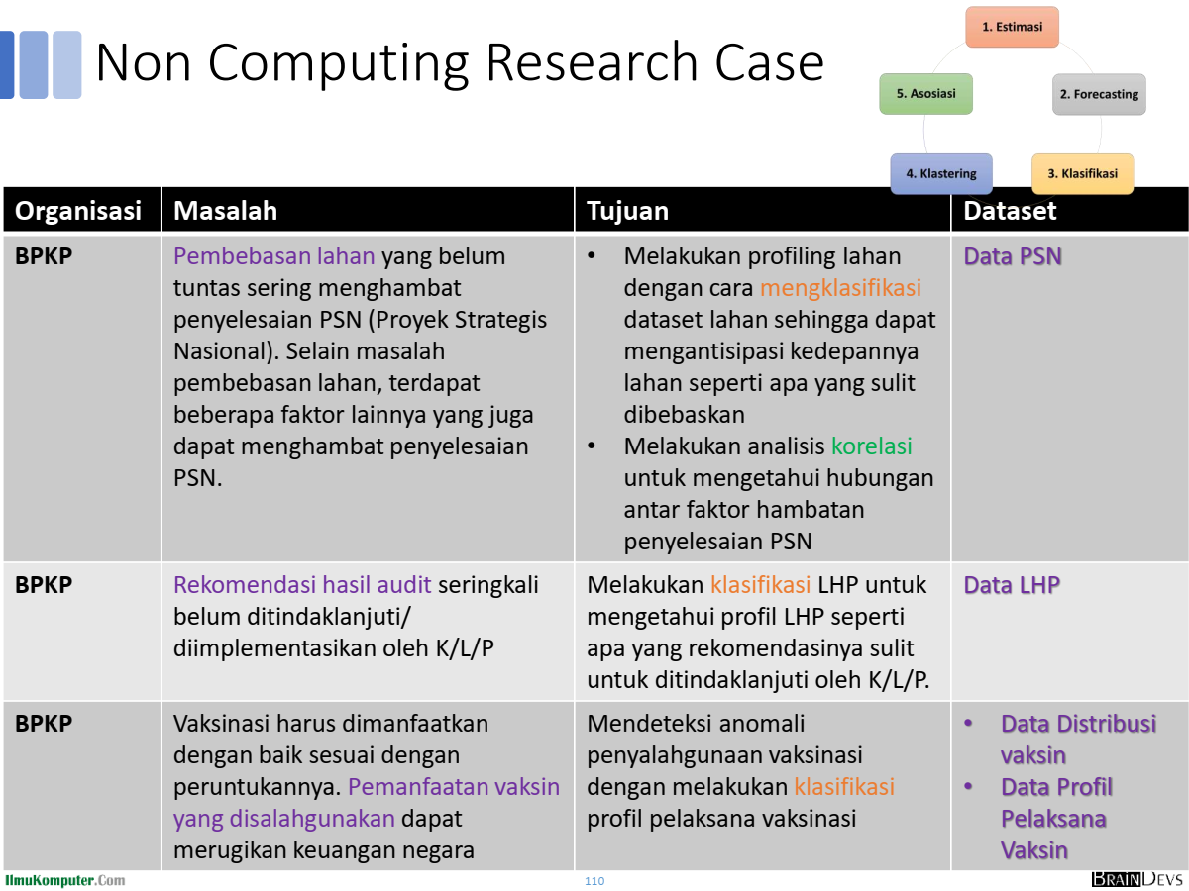

Slide 27
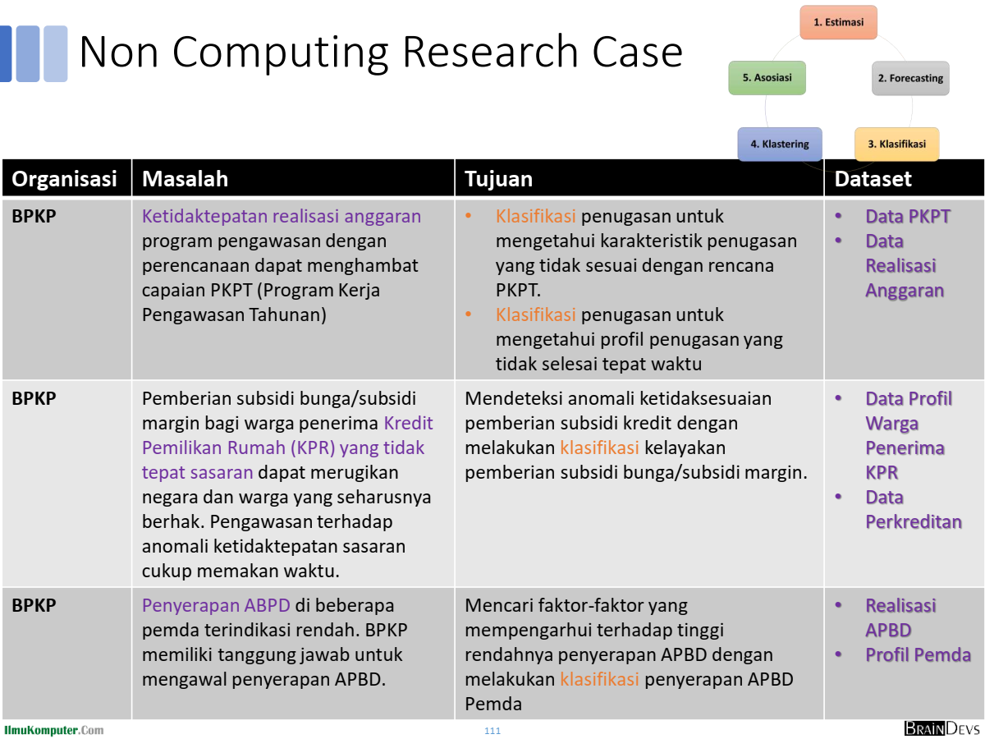

Slide 28
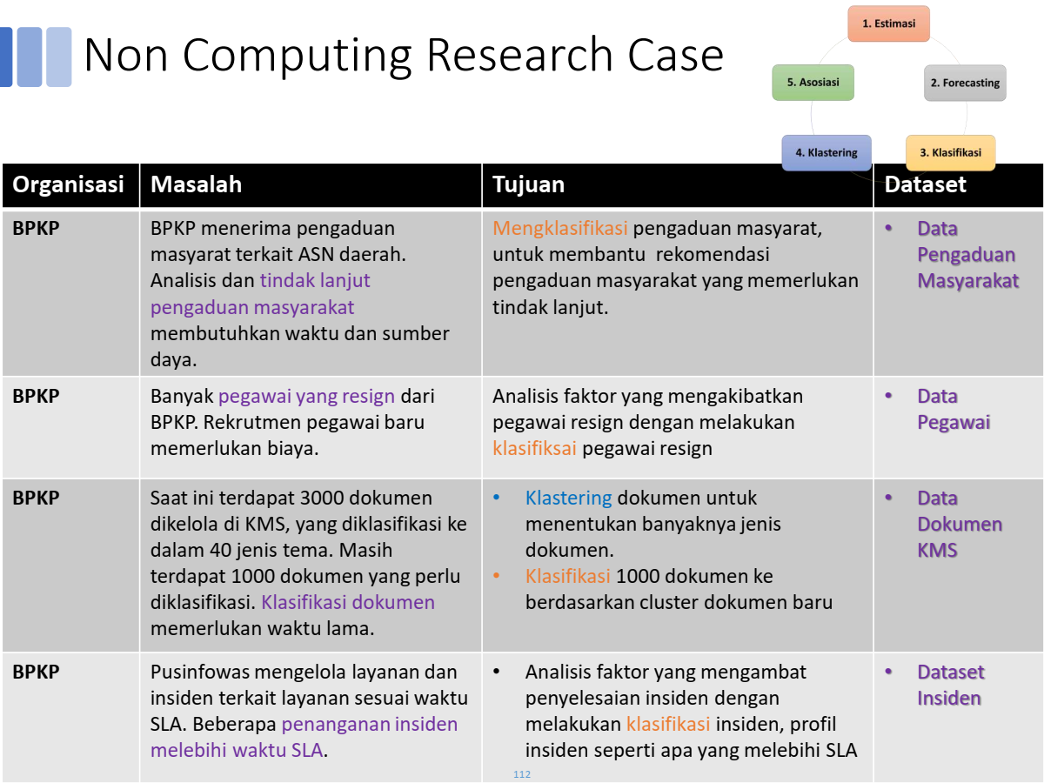

Slide 29
Lanjutan

Slide 30
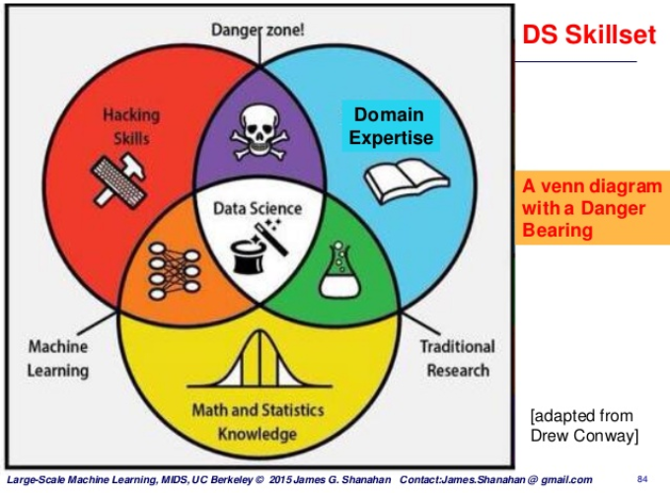
Data scientist
Data scientist is a person who is better at statistics than any software engineers and better at software engineering than any statistician.
(so obviously a physicist can do this!!, come on we have derived the theory of everything and we found the God particle.)
http://www.toprepo.com/demand-for-data-scientists/

Slide 31
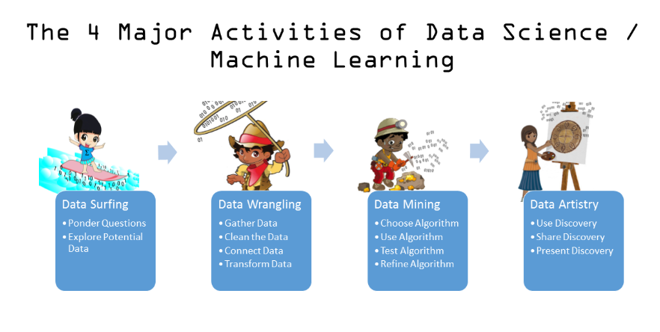
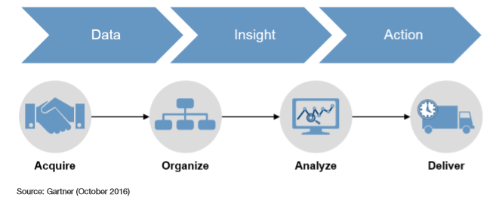
Data scientist
Source: jacobjwalker.effectiveeducation.org

Slide 32
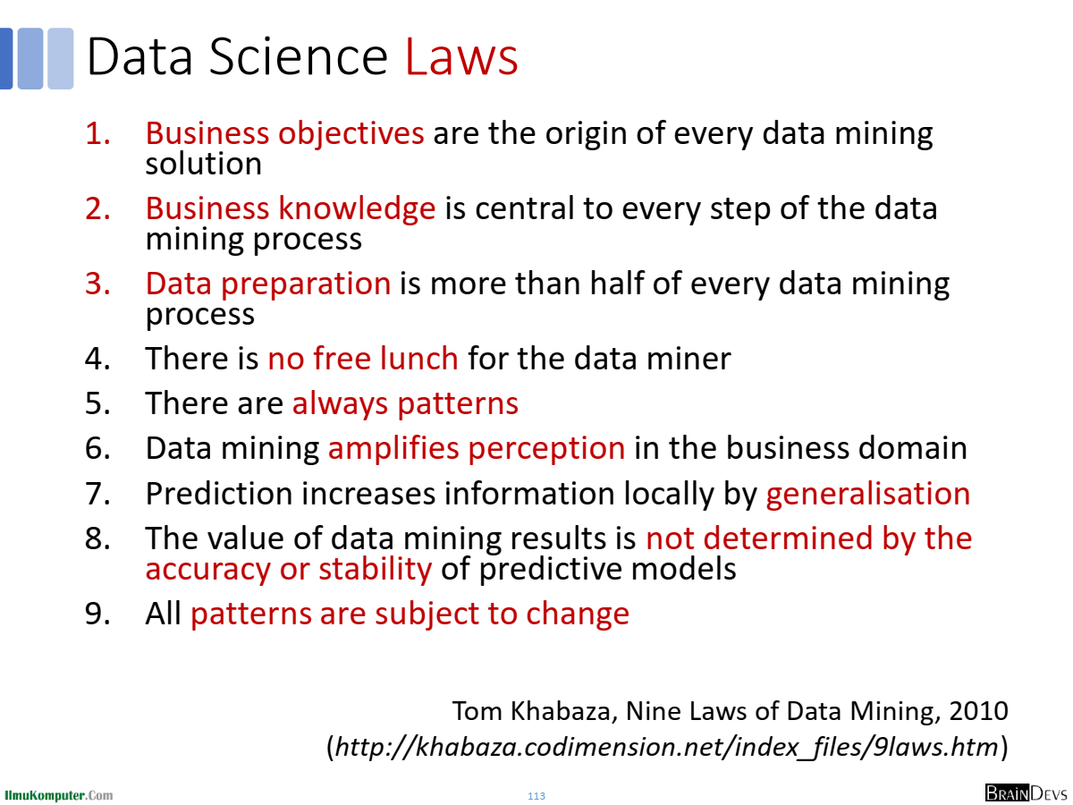

Slide 33
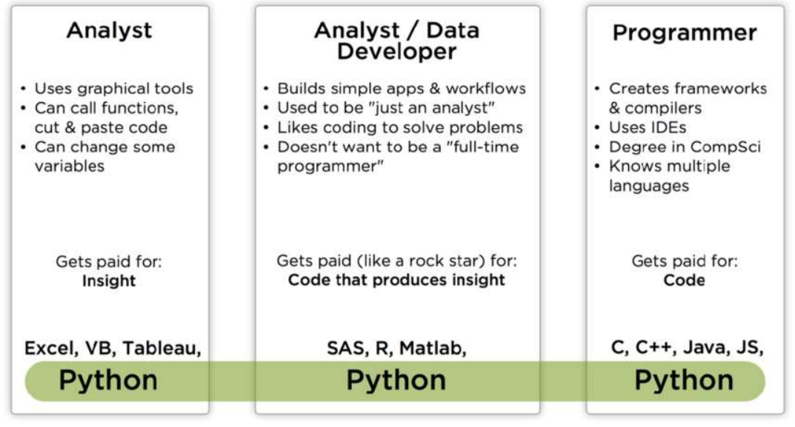
Tools for doing data science
P. Wang (Anaconda) & K Carlsson (Forrester) “Best Practice For Scaling Data Science Across the Organization” May 2018

Slide 34

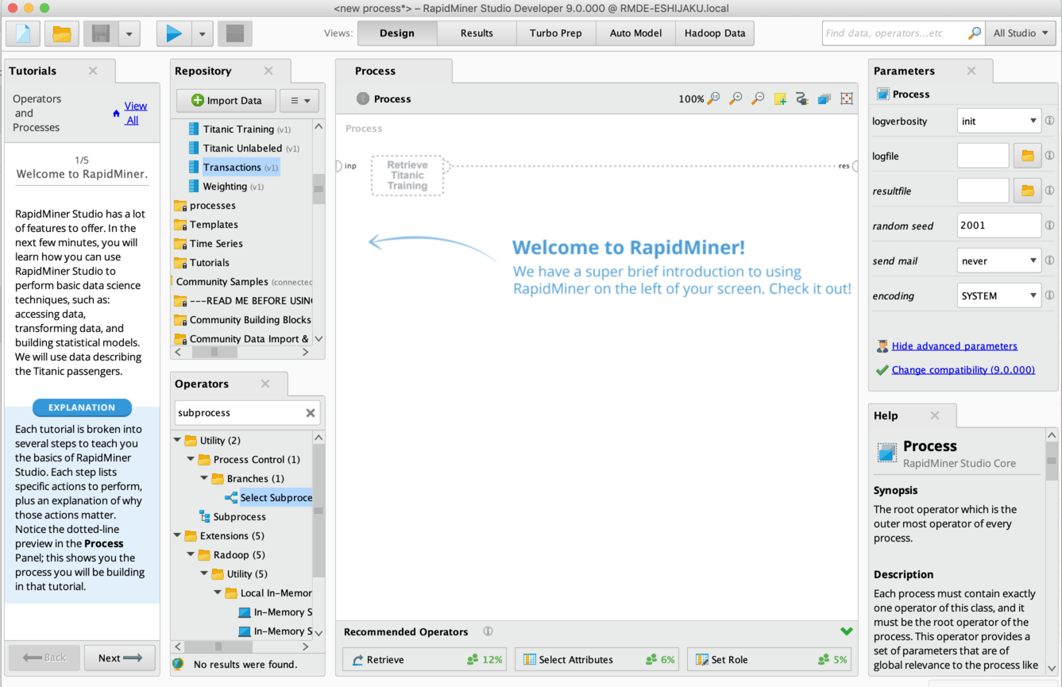
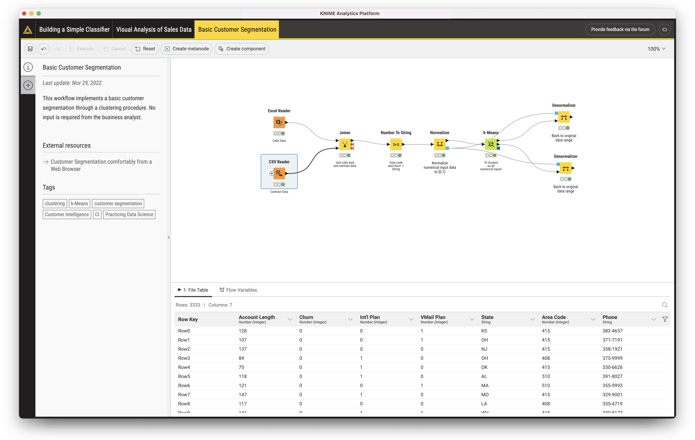
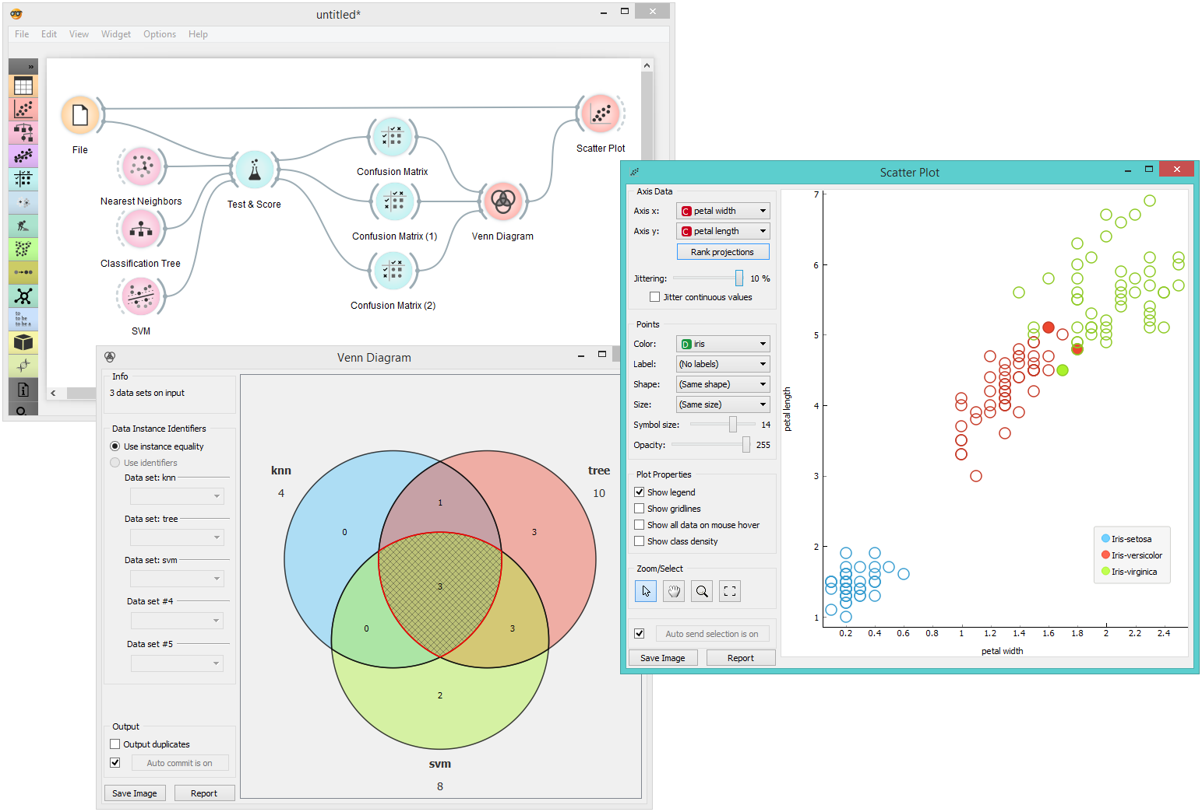
Data Mining Tools
Orange
RapidMiner
KNIME
https://orangedatamining.com/
https://rapidminer.com/
https://www.knime.com/

Slide 35
https://www.ibm.com/id-en/topics/artificial-intelligence

Slide 36
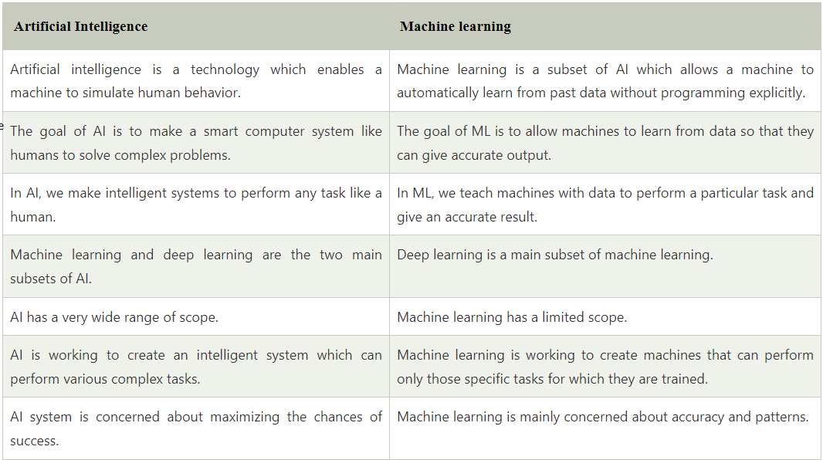
https://www.javatpoint.com/difference-between-artificial-intelligence-and-machine-learning

Slide 37
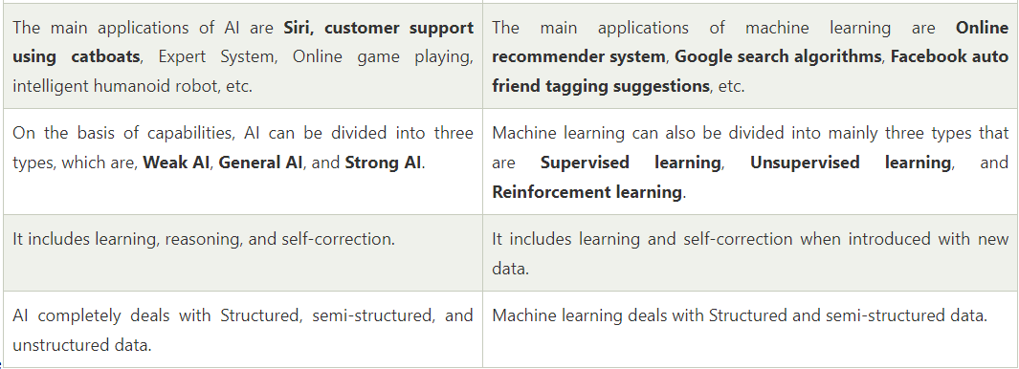
https://www.javatpoint.com/difference-between-artificial-intelligence-and-machine-learning

Slide 38
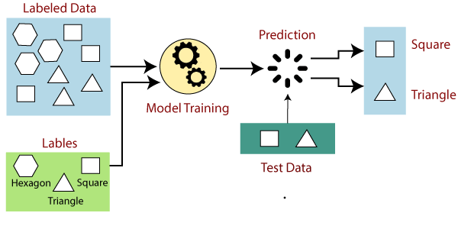
Supervised Learning
https://www.javatpoint.com/supervised-machine-learning

Slide 39
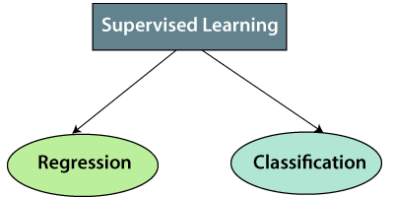
Supervised Learning
Linear Regression
Regression Trees
Non-Linear Regression
Bayesian Linear Regression
Polynomial Regression
Random Forest
Decision Trees
Logistic Regression
Support vector Machines
https://www.javatpoint.com/supervised-machine-learning
https://www.ibm.com/topics/supervised-learning

Slide 40
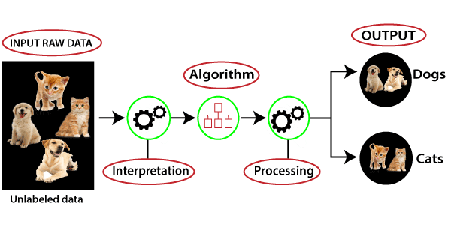
Unsupervised Learning
https://www.javatpoint.com/unsupervised-machine-learning

Slide 41
Supervised Learning
Unsupervised Learning
K-means clustering
Hierarchal clustering
Anomaly detection
Neural Networks
Principle Component Analysis
Independent Component Analysis
Apriori algorithm
Singular value decomposition
Clustering
Dimentionality Reduction
Principle Component Analysis
Singular value decomposition
Exploratory Data Analysis
Latent Semantic Analyst / Latent Semantic Indexing
Latent Dirichlet Allocation
Autoencoders
Association
Principle Component Analysis
Independent Component Analysis
Apriori algorithm
FP-growth
Latent Dirichlet Allocation
https://www.javatpoint.com/supervised-machine-learning
https://www.sumondey.com/machine-learning-part-5-clustering-and-arl/
https://www.geeksforgeeks.org/what-is-exploratory-data-analysis/

Slide 42
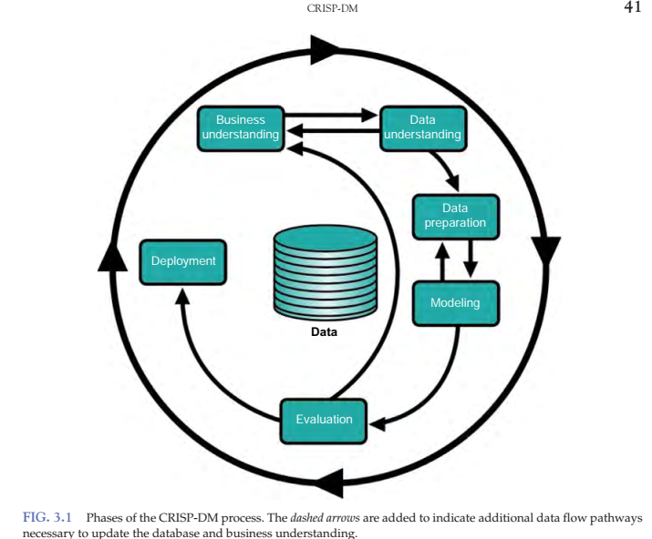
Cross-Industry Standard Process for Data Mining (CRISP-DM)
https://www.djkn.kemenkeu.go.id/artikel/baca/15134/CRISP-DM-Sebagai-Salah-Satu-Standard-untuk-Menghasilkan-Data-Driven-Decision-Making-yang-Berkualitas.html

Slide 43

Universitas Pamulang
Magister Teknik Informatika
Sajarwo Anggai
Dosen – Universitas Pamulang
NIDN : 0421108703
Email : dosen02832@unpam.ac.id
WA : 082343006557
Terima Kasih

